Slide 1
Management vs Labor:
The Struggle for Decent Wages and Weekends Off

Slide 2
Why did labor unions start?
Robber-barons didn’t respect their workers, and treated them horribly.
Separately, people began to believe that groups of people ought to be more powerful than even the strongest individuals.
“Socialism”
These two things combined to form unions, which used the power of the group to force management to show more respect for workers.

Slide 3
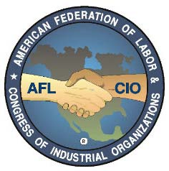
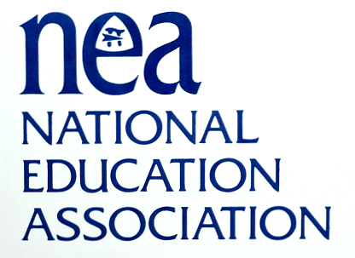
Big unions you should know:

Slide 4
Are they a good idea?
Labor Unions: Pro
Labor Unions: Con
They force management to think about their workers.
They allow workers to have a voice in the running of the company.
They guarantee that management cannot discipline or fire workers without “due process.”
A set of rules that determines what happens when workers don’t behave as management wants them to.
They lead to increased prices.
Why?
They protect incompetent employees.
In the public sector, they increase taxes.
Why?
They have, in some times and places, too much influence on politics and elections.
They sometimes strike without much provocation.
Nowadays, a lot of unions don’t seem to make sense… athletes, for example.
Ray Rice? Adrian Peterson?

Slide 5
Why this matters to you: A case study
Winthrop’s teachers are represented by the WTA, a part of the MTA, in turn a part of the NEA.
Our contract is collectively bargained, and lasts three years.
Our current contract expires in 2015.
What will be going on starting around now and lasting until the end of this school year?
Who does the WTA negotiate its contract with?

Slide 6
Why this matters to you: A case study
In the past, negotiations have sometimes been a problem. Usually, the problem centers around pay raises.
Our contract, like most, guarantees a cost-of-living adjustment (COLA) that raises our pay each year, normally by 1-3%. Often, the town wants us to take a 0% pay raise because it saves them money.
Way back in 2000, the WTA agreed to “take a zero” for the first time ever when the state cut the town’s mitigation funding.

Slide 7
Why this matters to you: A case study
Not surprisingly, a lot of WTA members disagreed with that contract.
Many older teachers in the town remain upset about it.
Every three years since, we’ve gotten stressed and nervous that we’ll have to take another zero.
This was a HUGE problem in 2006 and in 2009, though the 2012 negotiations went pretty smoothly.
Both sides sometimes played silly games.
And, when things looked like they wouldn’t go our way, what did the teachers do?

Slide 8
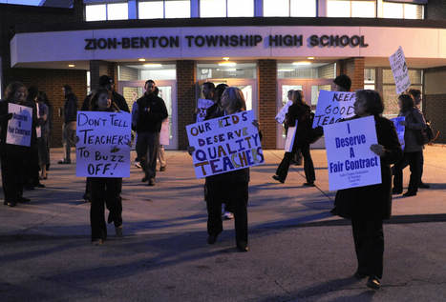
WTA Options: these are typical of most public unions (teachers, police, and fire)
First, you hand out leaflets and host coffees for important community members.
Second, you picket.

Slide 9
WTA Options: these are typical of most public unions (teachers, police, and fire)
Third, you picket some more.
Different locations, including the homes of school committee members!
This is as far as it got in 2006.
Fourth, you “work to rule.”
This is as far as it got in 2009. For us, it lasted about six weeks; other places have gone far longer (like, years).
Fifth, you go on strike.
Sixth, you go to jail… why?

Slide 10
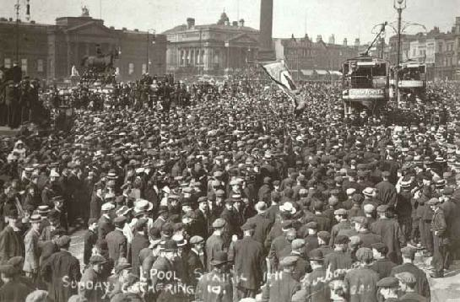
The dreaded “General Strike”
Generally, unions support other unions.
Sometimes, if one union decides to strike, many other unions will join in.
This is common in Europe, especially France.
Such general strikes will shut down entire cities and regions.
How?
Liverpool’s General Transit Strike, 1919

Slide 11
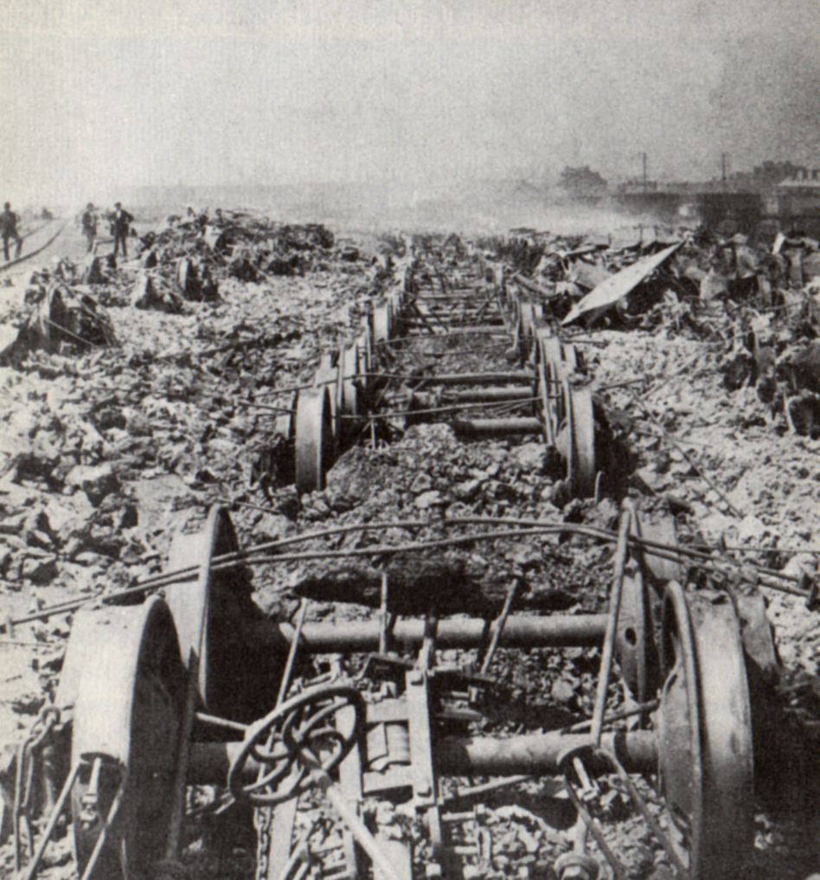
The Great Railroad Strike, 1877

Slide 12
The Haymarket Riot, 1886

Slide 13
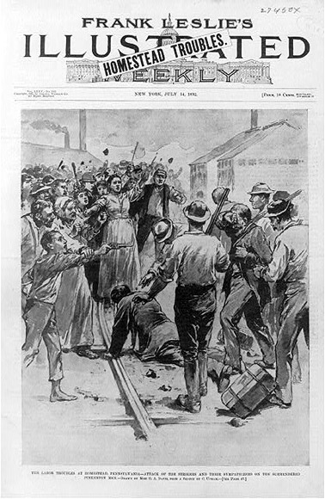
The Homestead Strike, 1892

Slide 14
The Pullman Strike, 1894

Slide 15
The Bread and Roses Strike, 1912

Slide 16
The Air Traffic Controllers’ Strike, 1981

Slide 17
Modern Unions…
…are in decline. American membership in unions is currently at an all-time low.
Unions no longer hold the political power they once had.
Why?
Many industries that depended on union labor are no longer as important.
MANUFACTURING!!!!

