Slide 1
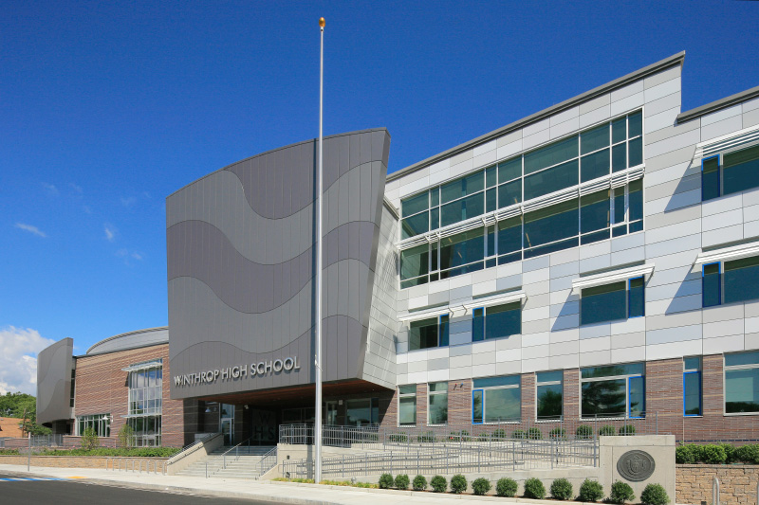
Welcome to Winthrop High School
Presenter: Mr. Crombie
High School Principal

Slide 2
High School Expectations
Start times
Attendance policy
Cell phone policy
Daily Schedule
Different level courses
GPA
Support Staff
Classroom Technology
Community Service
iPass/ iStudent/ iParent
Athletics/ Extracurricular activities
COVID 19 Protocols
Communication

Slide 3
School start/ end times
School starts at 7:35am and concludes at 2:00pm
First bell rings at 7:30am, no homeroom, head right to 1st block
Late bell rings at 7:35am
Students must be in their class by 7:35am or will be marked absent
Attendance is taken in every class
Excessive tardiness will result in disciplinary action

Slide 4
Attendance
What is an “AF”?
Attendance Failure
If a student has more than 3 unexcused absences in one quarter in a class they will receive an AF instead of their grade
If they receive an AF one quarter and don’t AF the next (don’t miss more than 3 classes) they will receive the grade they earned for that previous quarter (ex: AF Q1, don’t AF Q2 in Biology, then receives 85% Q1- grade earned)
If a student continues to AF consecutive quarters, you will receive a 59 for the previous quarter
Athletic requirements- if you have 2 AF’s or 2 F’s you cannot play in any games, but can practice with the team

Slide 5
What is an excused absence?
An illness documented by a medical/doctor’s note
Parents cannot write a note to excuse their student’s absence
A death in the family (parents/guardians must let front office know)
Religious holidays (parents/guardians must let front office know)
School sponsored activities, which were approved by administration
Court appearance (documentation from court required)
(Please note: family vacations are not excused absences)

Slide 6
Cell Phone Policy
When class is in session, cell phone usage is prohibited
Students should keep phone in your backpack when in class
Students are permitted to use it during lunch period or transition time only

Slide 7
Blocks | TIme | Day 1 | Day 2 | Day 3 | Day 4 | Day 5 | Day 6 | Day 7
1 | 7:35a - 8:45a | Periods
 |  | 1 | 6 | 4 | 2 | 7 | 5 | 3
2 | 8:49a - 9:59a | 2 | 7 | 5 | 3 | 1 | 6 | 4
3 | 10:03a - 11:13a | 3 | 1 | 6 | 4 | 2 | 7 | 5
4 | 11:17a - 12:47p | Lunch
 |  | 4 | 2 | 7 | 5 | 3 | 1 | 6
5 | 12:50p -2:00p | 5 | 3 | 1 | 6 | 4 | 2 | 7
Daily Schedule

Slide 8
Lunch Schedule
3 lunch blocks during block 4
1st lunch: 11:17am- 11:47am
2nd lunch: 11:47am- 12:17pm
3rd lunch: 12:17- 12:47pm
Rotates daily, depending on teacher
Every teacher has a different lunch schedule

Slide 9
iPass
iStudent/ iParent
Students and parents have separate username/passwords
To access- go to Winthrop High School’s website, click on “Family Information”, then iPass/ iParent login
Parents and students can view the following:
Grades
GPA
Class rank
Report Cards
Schedules
Classroom assignments

Slide 10
Course Levels
CP (“college preparatory”)
Honors
Accelerated
AP level (sophomore-senior year)
If a student is recommended to move from CP → honors, honors → accelerated or honors → AP level
More independent learning
Additional homework
Quicker pace
Cannot jump from CP → accelerated or AP

Slide 11
Grade Point Average (GPA)
A students’ GPA is a number that shows their overall academic performance for each year
GPA is used for the following:
Class rank
College admission
Scholarship opportunities
National Honor Society
Calculated twice a year (typically in January and June) after first semester and second semester final grades are posted

Slide 12
What happens if a student fails a class for the year?
If a student receives a final grade of 45- 59, they are eligible for summer school
In person and/or online credit recovery
If grade is below a 45, student will have to repeat class the following school year
This does negatively affect GPA

Slide 13
Classroom Technology
Each teacher uses iPass, Google classroom or Schoology to post grades
Will be provided a student and a parent code to access these online classrooms (class syllabus)
Parents and students can check grades on their teachers online classroom
Chromebooks will be distributed to all grade 9 students on first day of school

Slide 14
Support Staff
Teachers: Every teacher stays after school from 2:00pm- 2:30pm for extra help
Guidance Counselors: Kathleen D’Amico, Jessica Leslie, Annamaria Spiriti
D’Amico: A-F
Leslie: G-M
Spiriti: N-Z
Adjustment Counselors: Michael Kearney & Alison Lee

Slide 15
Support Staff cont’d
School Resource Officer: Detective Armitstead
Nurse: Virginia Pittman
Assistant Principal: Michael Capasso
Principal: Matthew Crombie
Special Education Director: Deb Earl
Athletic Director: Matt Serino

Slide 16
Community Service
60 hours of community service (15 hours each year)

Slide 17
Extracurricular Activities
Clubs
Robotics
STEM
Spilled Ink: literary mag
STUCO
Yearbook
Allies
Art
Drama Society
Digital Media
International
Math
Mock Trial
Model UN
Outdoors

Slide 18
Athletics
Fall Sports:
Football
Cheerleading
Girls/ Boys Soccer
Volleyball
Golf
Cross Country
Winter Sports:
Girls/ Boys Hockey
Girls/ Boys Basketball
Gymnastics
Swimming
Indoor Track
Winter Cheerleading
Spring Sports:
Baseball
Girls/ Boys Lacrosse
Softball
Girls/ Boys Tennis
Sailing
Girls/ Boys Track

Slide 19
Student Activities
Students of the term
Spirit Week
Homecoming Pep Rally
Thanksgiving Football Game
Powderpuff Football Game
Wellness week
Student Gov’t
Class President, VP, Treasurer, Videographer
Student Council Activities:
8th grade orientation
Freshman elections
NEMASC conferences
Bake sale
Mitten drive
Town wide cleanup
Blood drives

Slide 20
Masking/Covid 19 Protocols
Updated masking information and COVID 19 Protocols will be sent ASAP

Slide 21
Communication
Weekly Parent Email
Daily Student Email
WHS website
Principal’s Blog

Slide 22
Communication cont’d
School Contacts: Main Office, Teachers, Counselors, Administration
Response within 24 hours
Expectations
Partnership in Education

Slide 23
THANK YOU!
We look forward to working with you and your student this year!

